Slide 1

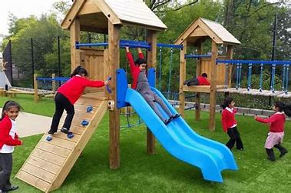
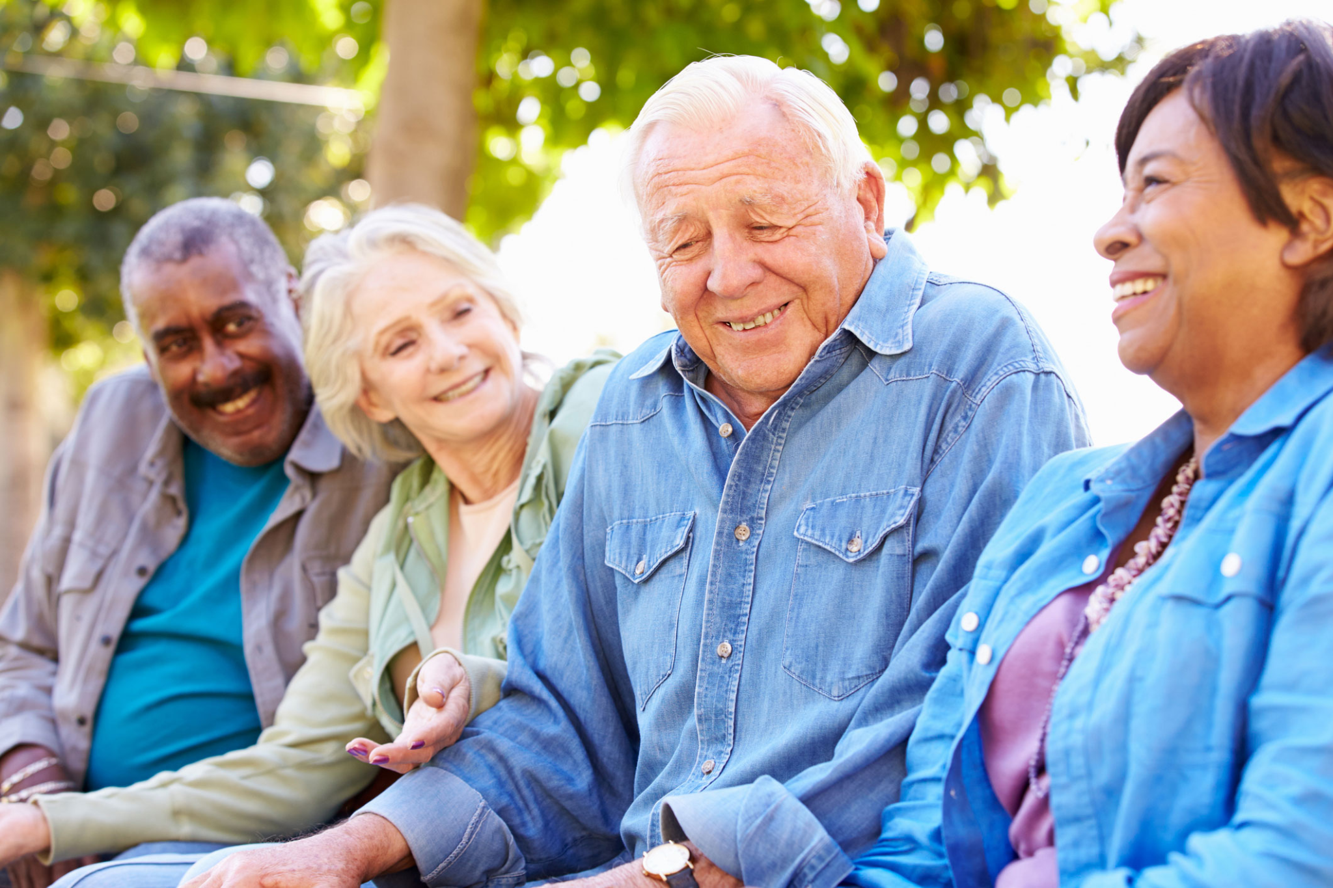
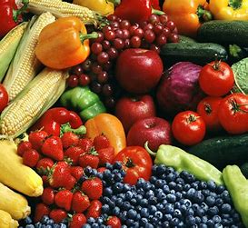
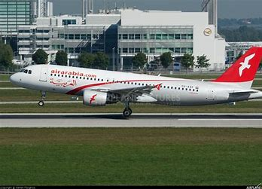
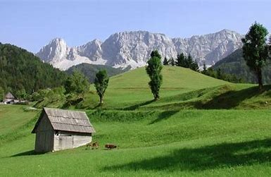
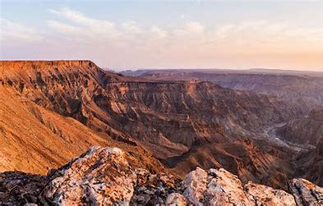


Image Caption Generator
Presented by:
Akansha Sharma Akshi Jain Bhavini Talach Charcha Galav Dimple Suthar
Project Guide:
Dr. Varun P. Saxena
Children playing on a wooden slide in a park

Slide 2


Abstract
Humans easily understand images encountered daily, but machines require captions for generating automatic descriptions. Image captioning improves the accuracy of image search and indexing. Despite advances in object recognition, machines still struggle to produce human-like descriptions. This project aims to assist blind individuals by converting image descriptions into speech, promoting independent navigation.

Slide 3

Goal
This project is aimed at assisting blind individuals. It converts image descriptions into speech, promoting independent navigation. This approach demonstrates significant advancements in artificial intelligence, offering meaningful and natural language descriptions for images across various applications.

Slide 4

Introduction
You saw an image and your brain can easily tell what the image is about, but can a computer tell what the image is representing?
Computer vision researchers worked on this a lot and they considered it impossible until now! With the advancement in Deep learning techniques, availability of huge datasets and computer power, we can build models that can generate captions for an image.

Slide 5

Features of Proposed System
Automatic Caption Generation:
The system automatically generates descriptive captions for images, providing meaningful and contextually relevant text that describes the visual content.
Audio Descriptions:
The system includes a feature that converts text captions into audio, providing spoken descriptions of the images. This is particularly useful for visually impaired users who rely on audio cues to understand visual content.
3. Multilingual Support:
It can produce captions in multiple languages, making it accessible to a diverse user base and allowing for global reach.

Slide 6
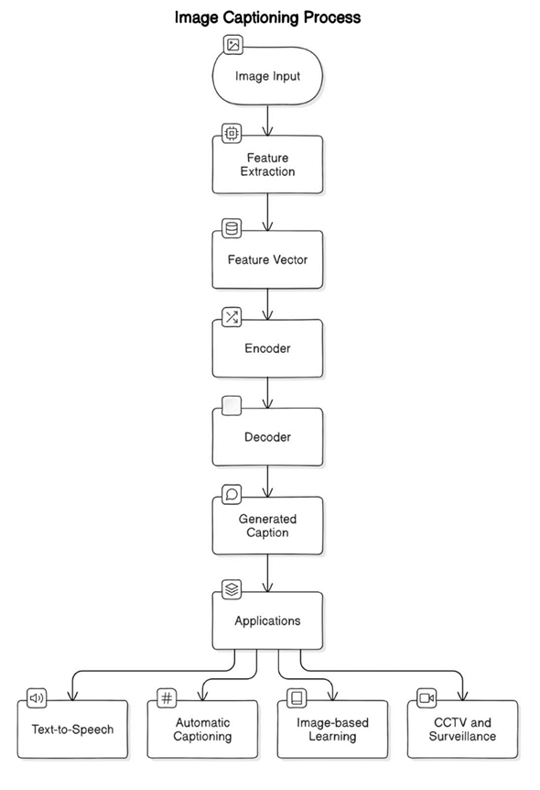

Slide 7
Models Employed
CNN(Convolutional Neural Network)
A Convolutional Neural Network (CNN) is a type of Deep Learning neural network architecture commonly used in Computer Vision. Computer vision is a field of Artificial Intelligence that enables a computer to understand and interpret the image or visual data.
When it comes to Machine Learning, Artificial Neural Networks perform really well.
Neural Networks are used in various datasets like images, audio, and text.
Different types of Neural Networks are used for different purposes, for example for predicting the sequence of words we use Recurrent Neural Networks, similarly for image classification we use CNN.

Slide 8
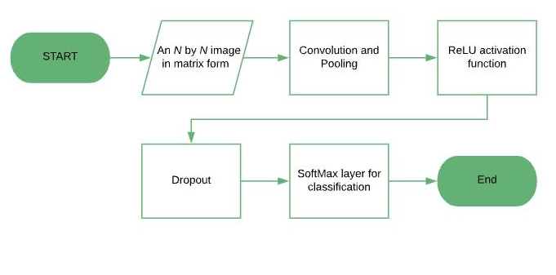
CNN Architecture

Slide 9
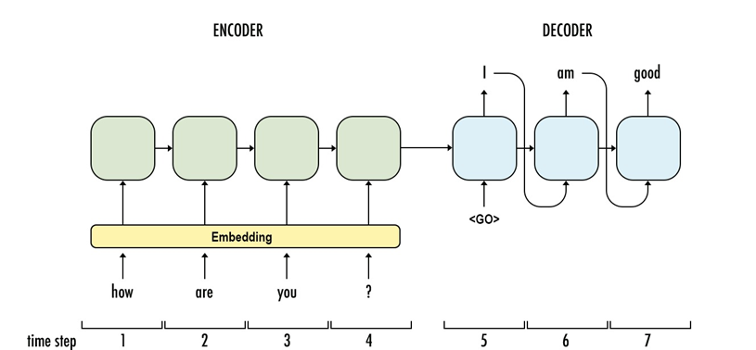
Cont.
Image Feature Extraction
EfficientNetB0 is a convolutional neural network architecture optimized for both accuracy and efficiency. It is one of the EfficientNet family models, which uses a compound scaling method to balance depth, width, and resolution to achieve better performance.
Transformer Encoder-Decoder Layer
For the Transformer part of the model, if you are using a standard Transformer architecture with 6 encoder layers and 6 decoder layers, you would add those layers to the total count. Each encoder and decoder layer typically has self-attention and feed-forward sub-layers.

Slide 10
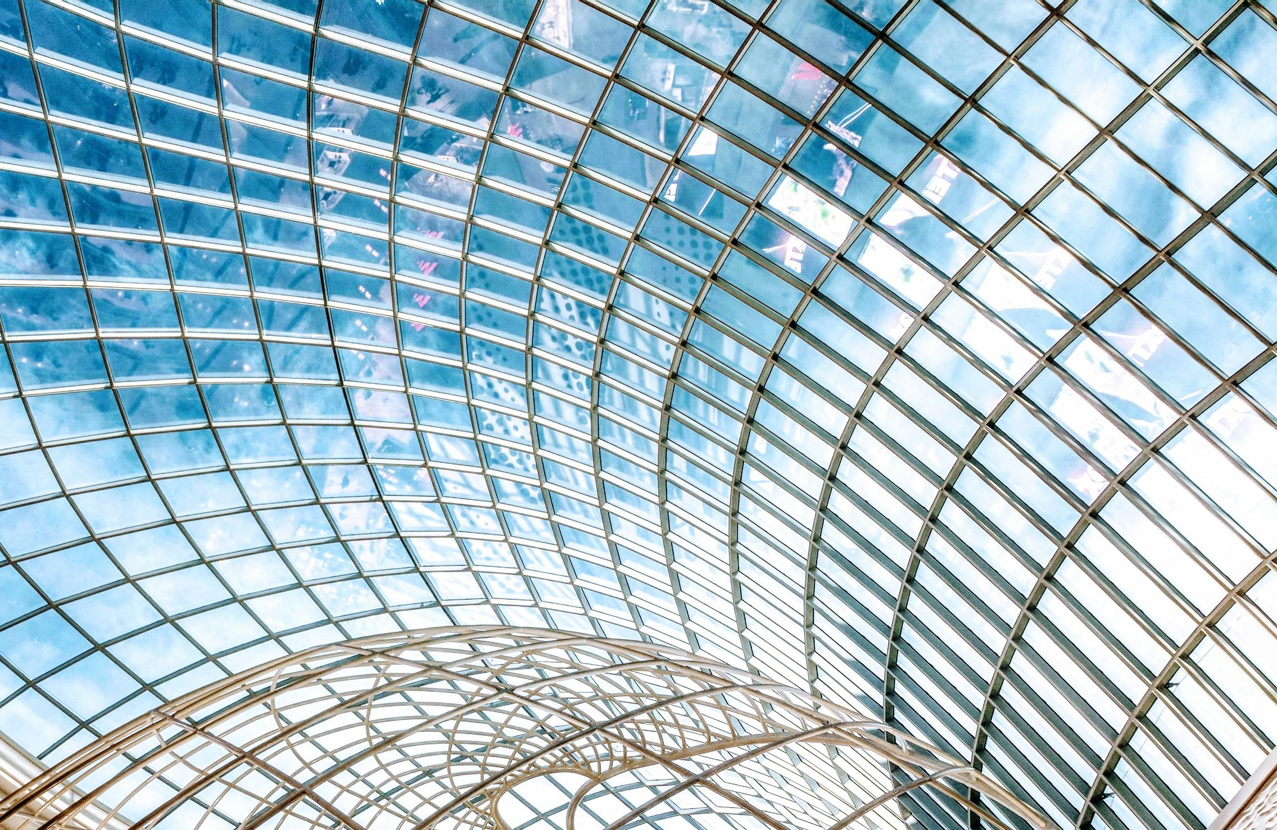
Python Libraries Employed
a. TensorFlow/Keras: These are the primary frameworks used for building and training the deep learning models. TensorFlow provides the backend computational power, while Keras offers a user-friendly interface for designing and training neural networks.
b. OpenCV: This library is used for image processing tasks, such as reading and writing images, and applying transformations like resizing and cropping.
c. NumPy: Essential for numerical computations and handling multidimensional arrays, which are integral to managing image and text data.
d. Text-to-Speech (TTS) gTTS (Google Text-to-Speech): This library is used to convert the generated captions into speech, enabling an auditory output for the captions.

Slide 11
Dataset Used
FLICKR8K DATASET
Flickr8k dataset is a public benchmark dataset for image to sentence description. This dataset consists of 8000 images with five captions for each image. These images are extracted from diverse groups in Flickr website.
The dataset has 6000 images in training dataset, 1000 images in development dataset and 1000 images in test dataset.

Slide 12
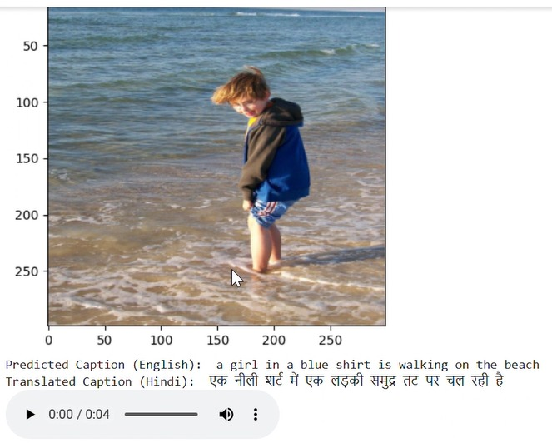
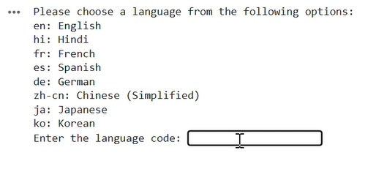
Proposed System Output
Language Translation Options
Final Output

Slide 13

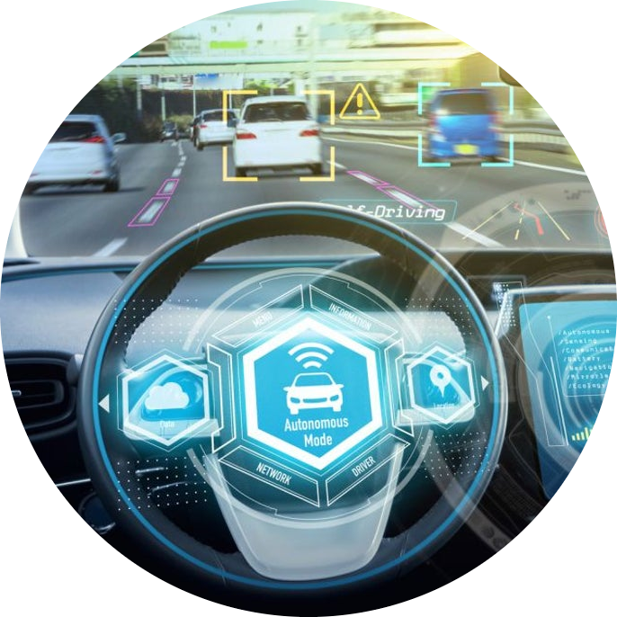
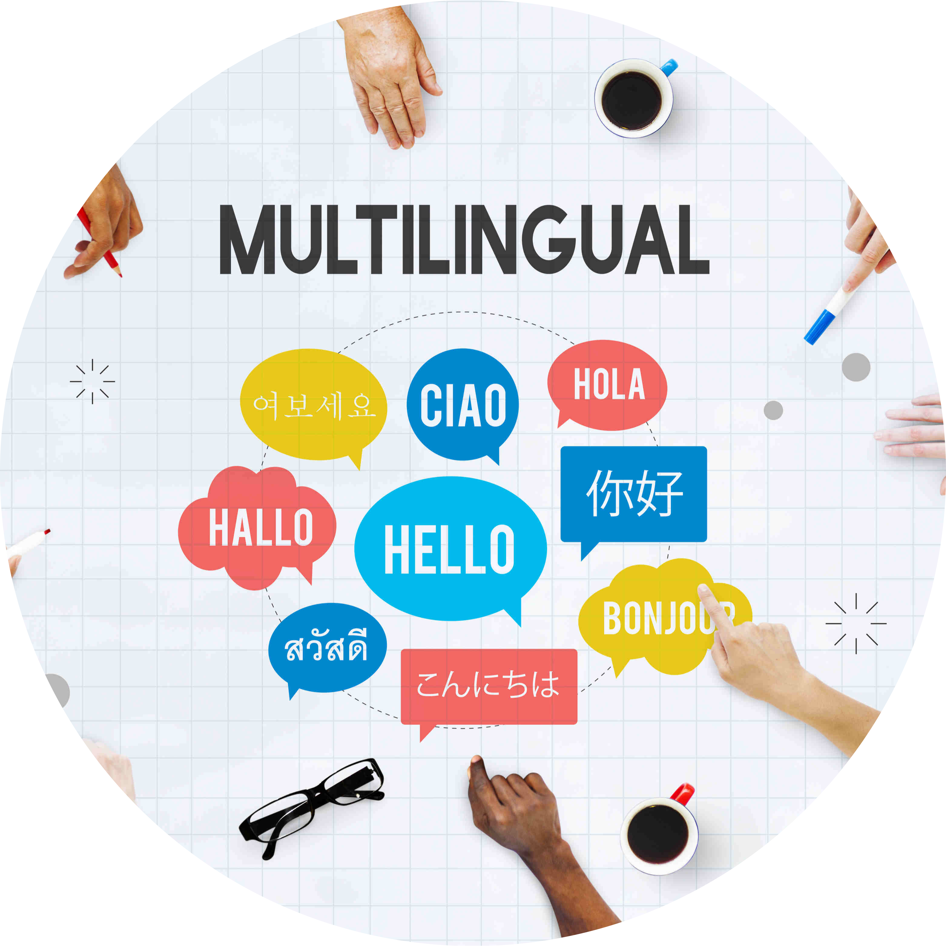
Applications
Enhanced Accessibility
Self-Driving Cars
Support for multilingual Content
Improves accessibility for visually impaired individuals by providing descriptive inclusivity and equal access to information.
Automatic driving is one of the biggest challenges and if we can properly caption the scene around the car, it can give a boost to the self driving system.
Generates captions in multiple languages, breaking language barriers and enabling global reach, beneficial for multinational platform.

Slide 14
Future Scope
1. Real-Time Video Captioning:
Extending capabilities to generate real-time captions for video content, providing descriptions for live events and streamed media.
2. Using larger dataset:
Training the model on larger and more diverse datasets can significantly improve the accuracy and quality of generated captions.
3. Developing a Front-End Application:
Creating a user-friendly front-end application will make the Image Caption Generator easily accessible to a broader audience.

Slide 15
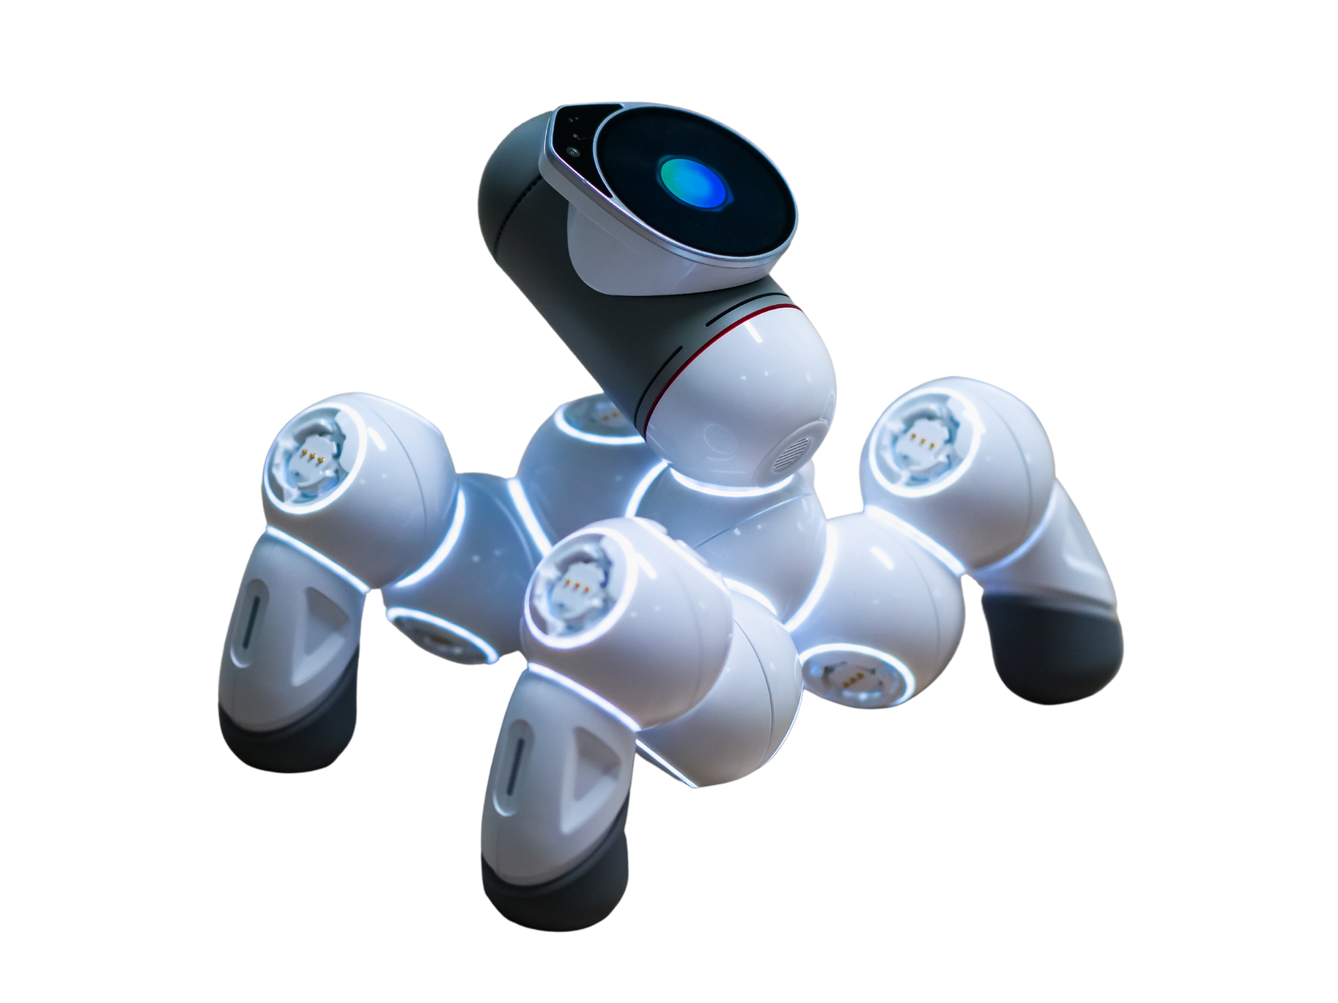
Conclusion
The successful implementation of this project showcases the capability of Deep learning to interpret visual content and translate it into coherent textual descriptions. This has significant implications for various applications, including assisting visually impaired individuals. Our model's integration with real-time translation services further broadens its usability, enabling caption generation in multiple languages and making the technology accessible to a global audience.

Slide 16
Thank You

